Slide 1
Internal validity and Instrumental Variables
Dr. Syed Hassan Raza
Assistant Professor of Economics
Quaid-i-Azam University

Slide 2
Internal validity
Internal validity is a crucial concept in applied economics because it ensures that our research accurately reflects the cause-and-effect relationships we are trying to study. Essentially, it helps us answer the question: Are the changes we observe in our dependent variable truly the result of our independent variable, or could there be other factors at play?

Slide 3
Key points about internal validity
Controlling for Confounding Variables:
In applied economics, we often deal with complex real-world situations. Internal validity requires us to control for confounding variables - those extra factors that could influence our results. By isolating our independent variable, we can be more confident that any changes in the dependent variable are due to our manipulation and not some external factor.

Slide 4
Key points about internal validity
Research Design and Methodology:
The way we design and conduct our research plays a crucial role in ensuring internal validity. A well-designed study minimizes the possibility of alternative explanations for the observed effects. This includes random assignment, careful sampling techniques, and robust statistical methods.

Slide 5
Key points about internal validity
Causal Inference:
Internal validity is all about making valid causal inferences. When we claim that changes in X cause changes in Y, we want to be sure that this is a legitimate and accurate statement. Internal validity helps us establish this causation without the interference of extraneous variables.

Slide 6
Key points about internal validity
Threats to Internal Validity:
It's important to be aware of potential threats to internal validity. Common threats include selection bias, maturation, history, and testing effects. By understanding these threats, we can take steps to mitigate them in our research designs.

Slide 7
Practical example
Minimum Wage Impact:
In applied economics, you might explore the impact of a minimum wage increase on employment levels. Internal validity is crucial to ensure that any observed changes in employment are indeed due to the minimum wage change and not influenced by other economic factors occurring simultaneously.

Slide 8
How to enhance internal validity?
In the realm of applied economics, internal validity remains a critical concern when establishing causal relationships between variables. Instrumental variables, or IVs, serve as a powerful tool to enhance internal validity by mitigating endogeneity issues, which could otherwise compromise the accuracy of our causal inferences.

Slide 9
Key points
Endogeneity and Internal Validity:
Endogeneity arises when an independent variable is correlated with the error term in a regression model, leading to biased and inconsistent estimates. This poses a threat to internal validity as it challenges our ability to isolate the true causal impact of the independent variable.

Slide 10
Key points
Purpose of Instrumental Variables:
Instrumental variables act as a solution to endogeneity. They are carefully chosen variables that are correlated with the endogenous independent variable but not directly with the dependent variable. By introducing these instruments into our model, we can address the endogeneity problem and enhance the internal validity of our analysis.

Slide 11
Key points
Identification Strategy:
Selecting a valid instrument is crucial for maintaining internal validity. The instrument must meet two key criteria: relevance and exogeneity. Relevance ensures that the instrument is correlated with the endogenous variable, while exogeneity ensures that the instrument is not directly related to the dependent variable, other than through its correlation with the endogenous variable.

Slide 12
Key points
Breaking the Endogeneity Loop:
Internal validity is at risk when endogeneity creates a feedback loop, making it challenging to disentangle cause and effect. Instrumental variables effectively break this loop, allowing us to isolate the causal impact of the independent variable on the dependent variable.

Slide 13
Practical Examples
Education and Income:
Suppose we are examining the impact of education on income. Endogeneity could arise if unobserved factors, such as innate ability, affect both education and income. By using an instrumental variable, like proximity to a good school, we can address this endogeneity and enhance the internal validity of our analysis.

Slide 14
Threats to internal validity
Three endogenous in OLS regression are:
Omitted Variable Bias(a variable that is correlated with X but is unobserved)
Simultaneity or reverse causality Bias (X causes Y,Y causes X)
Errors-in-Variables Bias (X is measured with error)
One easy way to deal with these endogeneity is using Instrumental Variable method.

Slide 15
Introduction to iv method
The earliest application involved attempts to estimate demand and supply curve for product.
A simple but difficult question: How to find the supply or demand curves?
Difficulty: We can only observe intersections of supply and demand, yielding pairs.
Solution: Wright(1928) use variables that appear in one equation to shift this equation and trace out the other.
The variables that do the shifting came to be known as Instrumental Variables method.
It is well-known that IV can address the problems of omitted variable bias, measurement error and reverse causality problems.

Slide 16
Terminology: endogeneity and exogeneity
An endogenous variable is one that both we are interested in and is correlated with u.
An exogenous variable is one that is uncorrelated with u.
Historical note: “Endogenous” literally means “determined within the system,” that is, a variable that is jointly determined with Y, that is, a variable subject to simultaneous causality.
However, this definition is narrow and IV regression can be used to address OVB and errors-in-variable bias, not just to simultaneous causality bias.

Slide 17
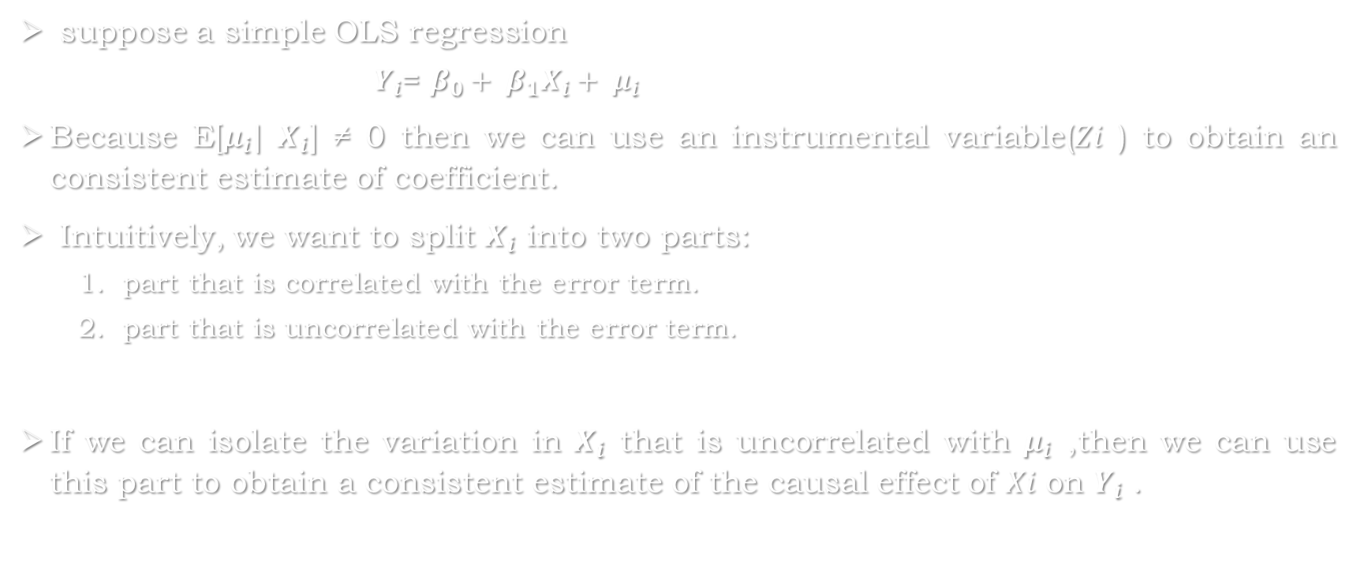
Instrumental variables: 1 endogenous regressor & 1 instrument
suppose a simple OLS regression
$Y_{i}$= $β_{0}+ β_{1}X_{i}+ μ_{i}$
Because E[$μ_{i}|$ $X_{i}$] ≠ 0 then we can use an instrumental variable(𝑍𝑖 ) to obtain an consistent estimate of coefficient.
Intuitively, we want to split $X_{i}$ into two parts:
part that is correlated with the error term.
part that is uncorrelated with the error term.
If we can isolate the variation in $X_{i}$ that is uncorrelated with $μ_{i}$ ,then we can use this part to obtain a consistent estimate of the causal effect of 𝑋𝑖 on $Y_{i}$ .

Slide 18
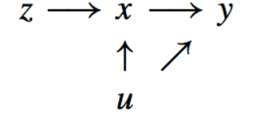
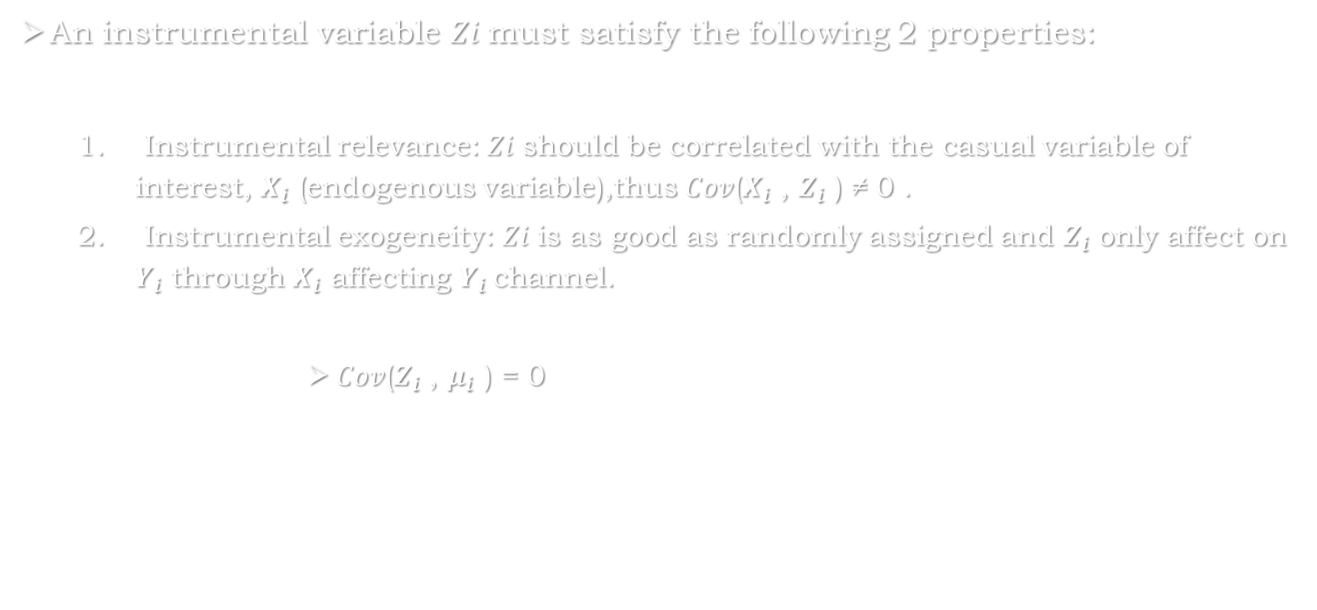
Instrumental variables: 1 endogenous regressor & 1 instrument
An instrumental variable 𝑍𝑖 must satisfy the following 2 properties:
Instrumental relevance: 𝑍𝑖 should be correlated with the casual variable of interest, $X_{i}$ (endogenous variable),thus 𝐶𝑜𝑣($X_{i}$ , $Z_{i}$ ) ≠ 0 .
Instrumental exogeneity: 𝑍𝑖 is as good as randomly assigned and $Z_{i}$ only affect on $Y_{i}$ through $X_{i}$ affecting $Y_{i}$channel.
𝐶𝑜𝑣($Z_{i}$ , $μ_{i}$ ) = 0

Slide 19

IV estimator: Jargon
Our simple OLS regression: Causal relationship of interest
$Y_{i}$= $β_{0}+ β_{1}X_{i}+ μ_{i}$
First-Stage regression: regress endogenous variable on IV
$X_{i}$ = $π_{0}$+ $π_{1}Z_{i}$ + $v_{i}$
Reduced-Form: regress outcome variable on IV
$Y_{i}$ = $δ_{0}$ + $δ_{1}$ $Z_{i}$ + $e_{i}$

Slide 20

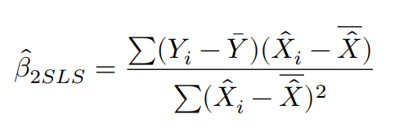
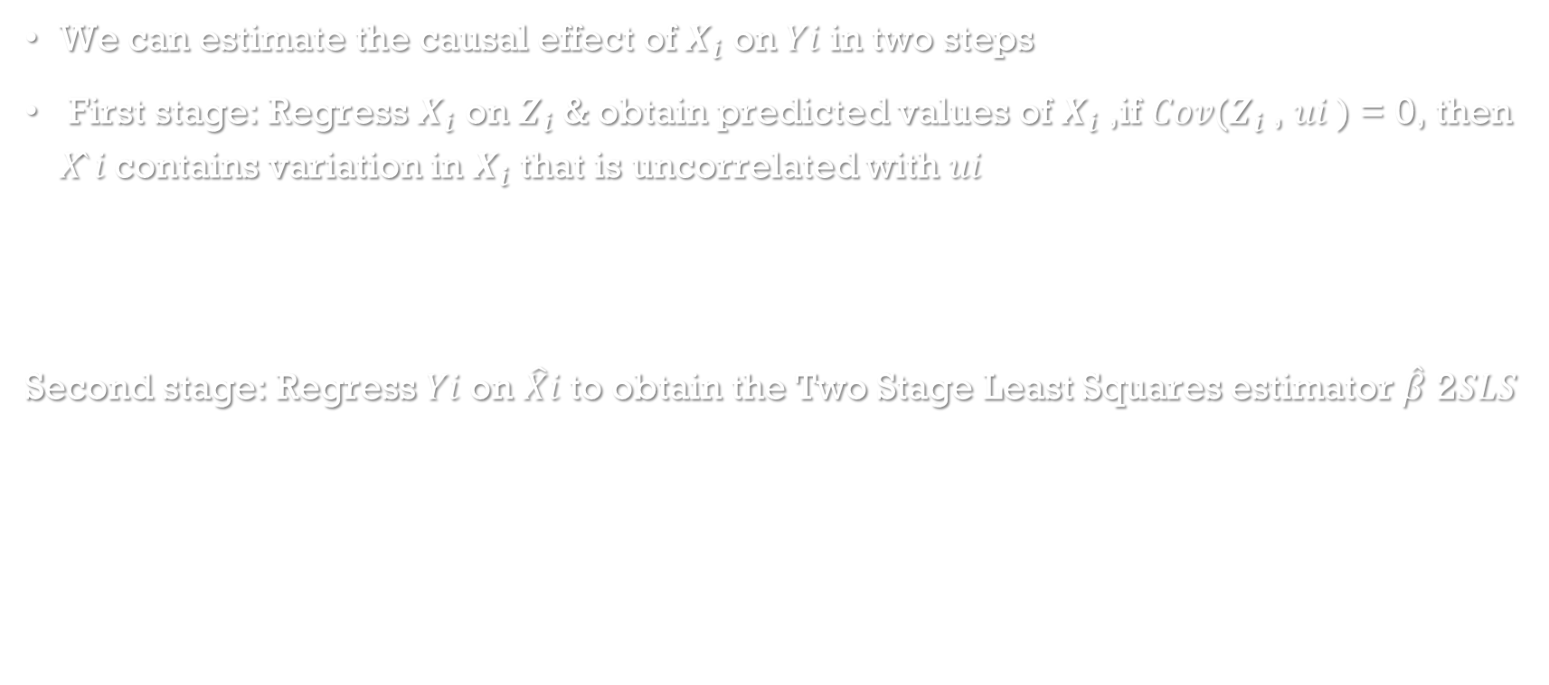
IV estimator: Two Stage Least Square (2SLS)
We can estimate the causal effect of $X_{i}$ on 𝑌𝑖 in two steps
First stage: Regress $X_{i}$ on $Z_{i}$ & obtain predicted values of $X_{i}$ ,if 𝐶𝑜𝑣($Z_{i}$ , 𝑢𝑖 ) = 0, then 𝑋̂ 𝑖 contains variation in $X_{i}$ that is uncorrelated with 𝑢𝑖
Second stage: Regress 𝑌𝑖 on $\hat{X}$𝑖 to obtain the Two Stage Least Squares estimator $\hat{β}$ 2𝑆𝐿𝑆

Slide 21

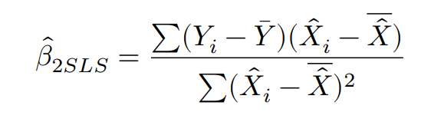
IV estimator：Two StAGE Least Square (2SLS)
We substitute
Then we could obtain

Slide 22

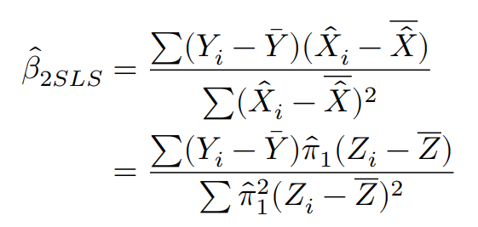
IV estimator：Two Steps Least Square (2SLS)
We substitute
Then we could obtain

Slide 23
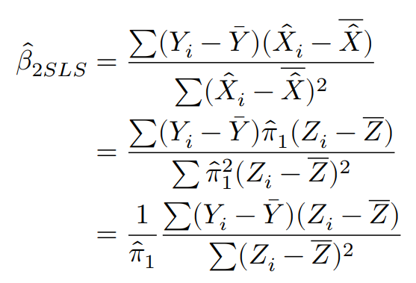
IV estimator：Two Stage Least Square (2SLS)
We substitute
Then we could obtain

Slide 24
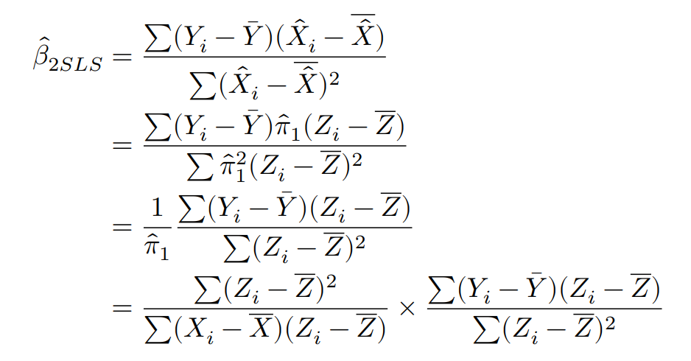
IV estimator：Two Stage Least Square (2SLS)
Then we could obtain

Slide 25
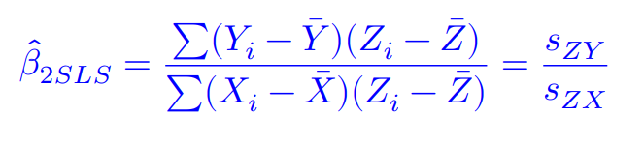


IV estimator：Two Stage Least Square (2SLS)
Which gives the instrumental variable estimator
The TSLS estimator of $β_{1}$is the ratio of the sample covariance between 𝑍 and 𝑌 to the sample covariance between 𝑍 and 𝑋.
If $Z_{i}$ = $X_{i}$ , then

Slide 26
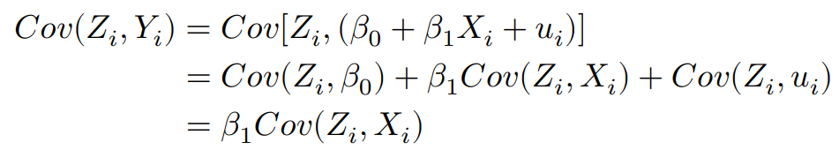
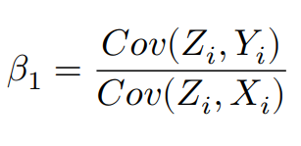
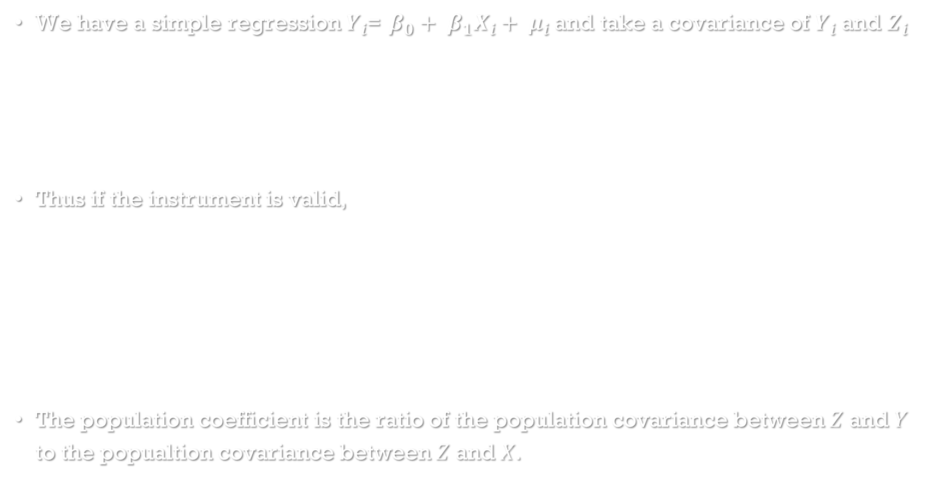
Statistical propertise of 2SLS estimator: Consistent
We have a simple regression $Y_{i}$= $β_{0}+ β_{1}X_{i}+ μ_{i}$and take a covariance of $Y_{i}$ and $Z_{i}$
Thus if the instrument is valid,
The population coefficient is the ratio of the population covariance between 𝑍 and 𝑌 to the popualtion covariance between 𝑍 and 𝑋.

Slide 27
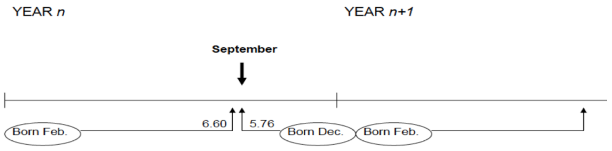
Application: Angrist and Krueger(1991)
Why is the Quarter of Birth?
In most of the U.S. must attend school until age 16 (at least during 1938-1967)
Age when starting school depends on birthday, so grade when can legally drop out depends on birthday by compulsory schooling laws.

Slide 28
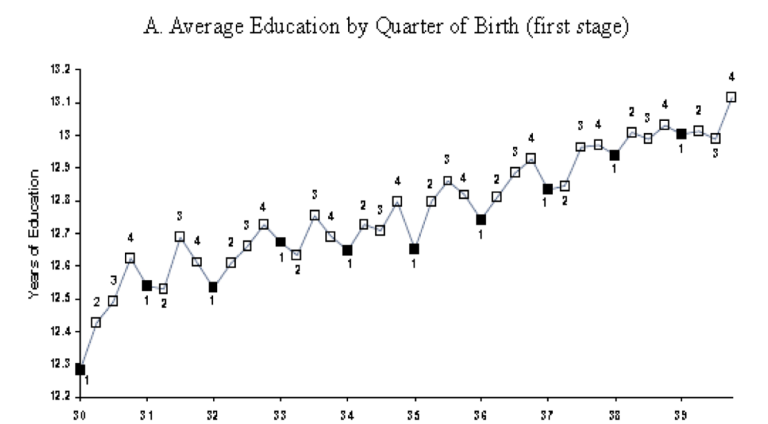
Application: Angrist and Krueger(1991)
Is Schooling related to Quarter of Birth?(Assumption 1)

Slide 29

Angrist and Krueger(1991): The First Stage
Does quarter of birth affect education?
Regress education outcomes on quarter of birth dummy variables:
where individual 𝑖, cohort 𝑐, education outcome 𝑆, birth quarter 𝑄𝑗
It is the first stage regression

Slide 30
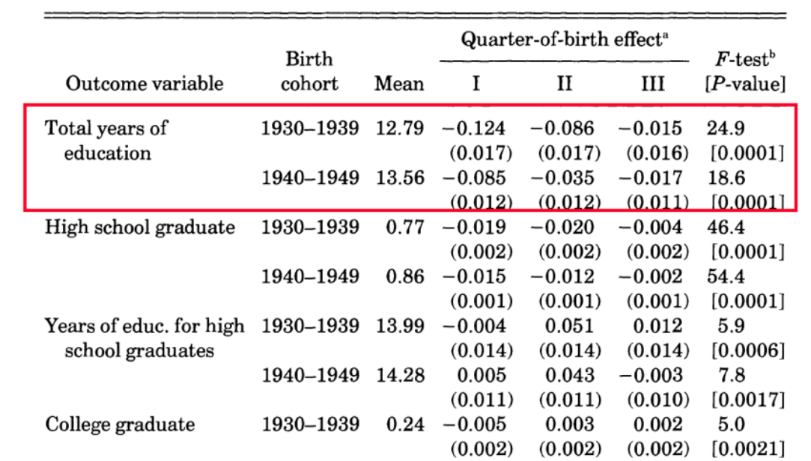
Angrist and Krueger(1991): The First Stage
It shows that 𝑄𝑗 does impact education outcomes such as total years of education and high school graduation.

Slide 31
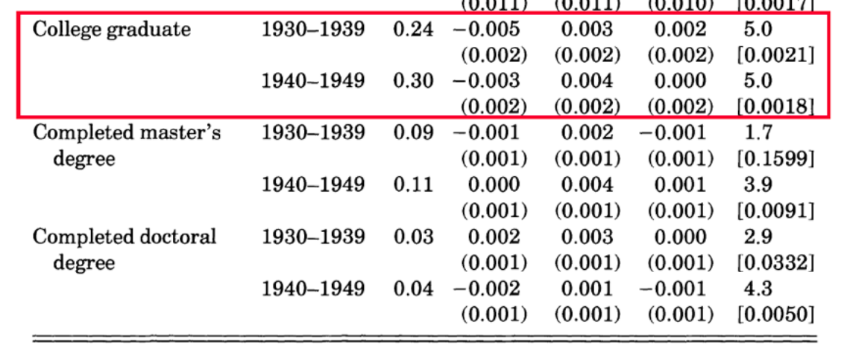
Angrist and Krueger(1991): exogeneity
Due to compulsory schooling laws?
Indirect evidence: on post-secondary outcomes that are not expected to be affected by compulsory schooling laws.

Slide 32
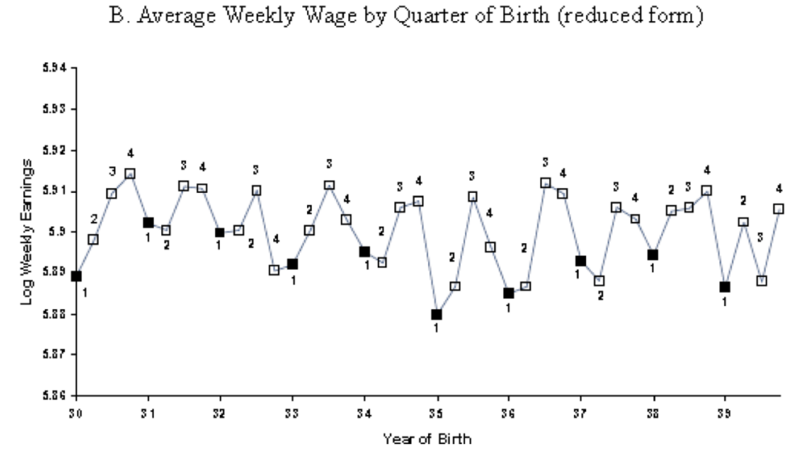
Angrist and Krueger(1991): Reduced form
Is Earnings related to Quarter of Birth?

Slide 33
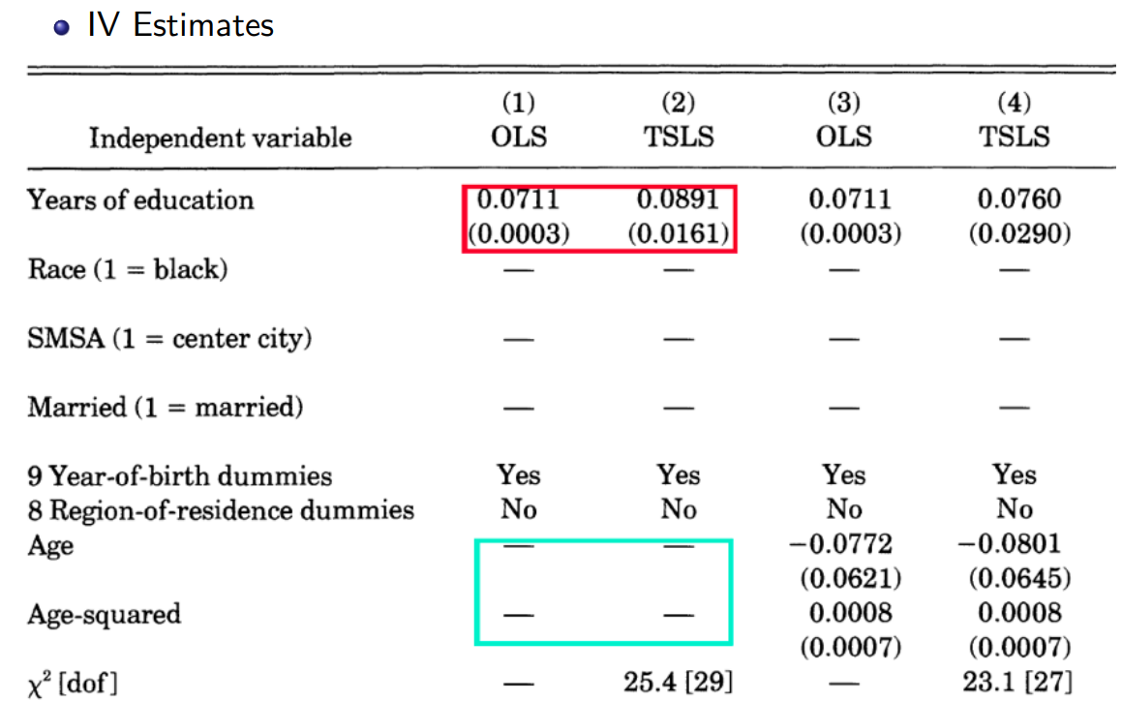
Angrist and Krueger(1991): OLS v.s IV

Slide 34
Checking Instrument validity
Assumption #1 Instrument Relevance
Instrumental strategy that seems very robust.
But how to understand that Angrist and Krueger(1991) IV’s result larger than that of OLS?
Bound et al(1995) prove that when instruments have limited explanatory power over endogenous variable, 1.IV is biased towards OLS in finite samples. 2.May happen even on very large sample

Slide 35
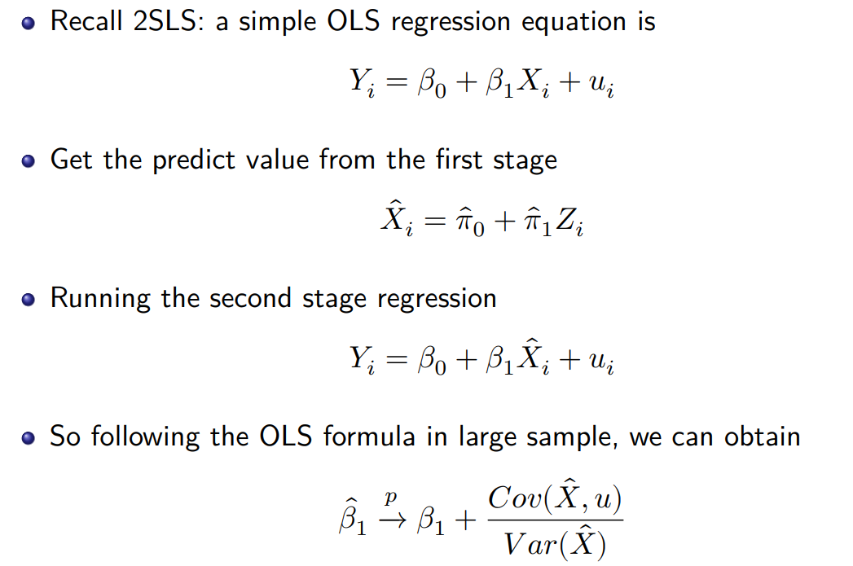
Assumption #1 Instrument Relevance

Slide 36
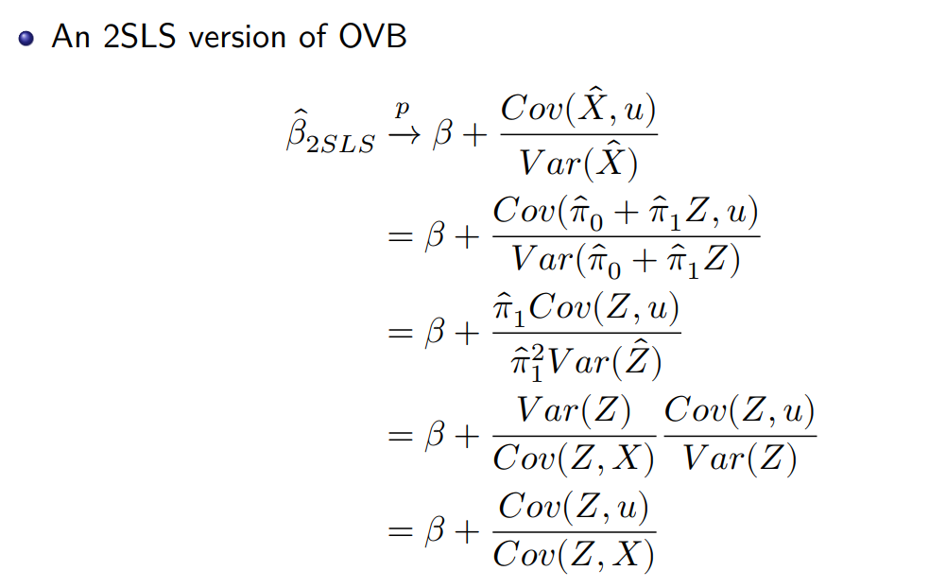
Assumption #1 Instrument Relevance

Slide 37

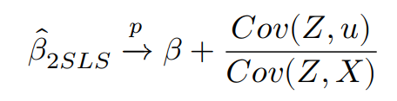
Weak Instruments
Assumption 1: Instrument Relevance
Intuition: the more the variation in 𝑋 is explained by the instruments, thus the more information is available for use in IV regression
On the contrary, instruments explain little of variation in 𝑋 are called Weak Instruments, thus there is a very weak correlation between 𝑋(endogenous variable) and 𝑍(IV).
Because
So if 𝐶𝑜𝑣(𝑍, 𝑋) = 0,thus 𝑋 and 𝑍 is irrelevant,the bias will approximate to infinity.

Slide 38
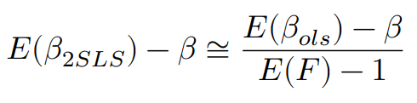
Weak Instruments: How to test weak instruments ?
We should therefore always check whether an instrument is relevant enough.
Compute the first stage F-statistic provide a measure of the in formation content contained in the instruments.
Stock and Yogo(2005) showed that
𝐸(𝐹) is the expectation of the first stage F-statistics.And if 𝐸(𝐹) = 10,the bias of 2SLS, relative to the bias of OLS,is approximately 1 9 , which is small enough to be acceptable.
A Rule of Thumb: if F-statistic exceeds 10,then don’t need worry about too much.

Slide 39
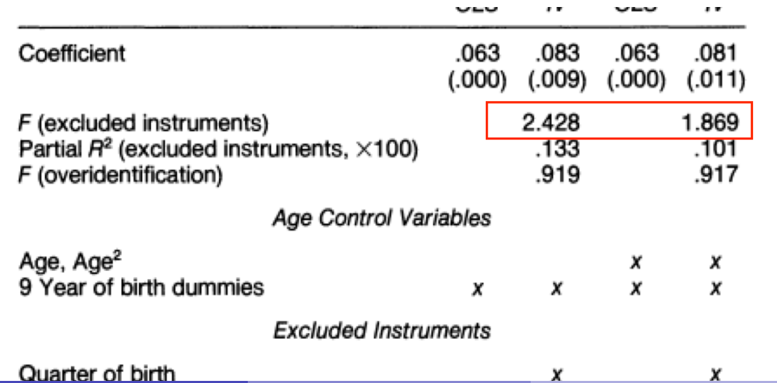
Angrist and Krueger(1991): Why IV over OLS?
In Angrist and Krueger(1991),despite large samples sizes, the F-statistics for a test of the joint statistical significance of the excluded exogenous variables in the first-stage regression are not over 2.

Slide 40
Wrap up
If the correlation between the instruments and the endogenous variable is small, then even the enormous sample sizes do not guarantee that quantitatively important finite sample biases will be eliminated from IV estimates.
The first assumption of IV method, thus relevance of IV, can be justified by the F-statistic in the first stage.
Potential Solutions
If you have many IVs, some are strong, some are weak. Then discard weak ones.
If you only have an weak IV, then find other more stronger IV(easy to say, very hard to do)
Employing other estimator(LIML) other than 2SLS methods.

Slide 41
Assumption #2 Instrument Exogeneity
If the instruments are not exogenous, then TSLS is inconsistent.
After all, the idea of instrumental variables regression is that the instrument contains information about variation in 𝑋𝑖 that is unrelated to the error term 𝑢𝑖.
Can we statistically test the assumption that the instruments are exogenous?
Answer: In most case, NO.
Assessing whether the instruments are exogenous necessarily requires making an expert judgment based on personal knowledge and expert opinion of the application.
In some case, you can test partially, thus overidentification test.

Slide 42
Assumption #2 Instrument Exogeneity
Terminology: The relationship between the number of instruments(𝑚) and the number of endogenous regressors(𝑘)
exactly(just) identified:𝑚 = 𝑘
overidentified 𝑚 > 𝑘
underidentified 𝑚 < 𝑘
when the coefficients are just identified, you can’t do a formal statistical test of the hypothesis that the instruments are in fact exogenous.
If, however, there are more instruments than endogenous regressors, then there is a statistical tool that can be helpful in this process: the so-called test of overidentifying restrictions.

Slide 43
Overidentification-test:Intuition
Suppose there are two valid instruments: 𝑍1 𝑍2 (you are very lucky.)
Then you could compute two separate TSLS estimates.
Intuitively,if these 2 TSLS estimates are very different from each other, then something must be wrong: one or the other (or both) of the instruments must be invalid.
The overidentifying restrictions test makes this comparison in a statistically precise way.

Slide 44
Thank you

